Slide 1





Air Quality Pattern Analysis
Presentor: Vrushali Khatane

Slide 2
Table of contents
01
02
03
04
05
06
Project Objective
Dataset Overview
Data Cleaning
Exploratory Data Analysis
Dimensionality Reduction (Randomized SVD)
Predictive Modeling

Slide 3
01
Project Objective
Analyze air quality data for insights into pollution metrics.
Perform clustering to identify patterns in air quality.
Apply dimensionality reduction (Randomized SVD) for efficient modeling.
Evaluate predictive performance for pollution levels.

Slide 4
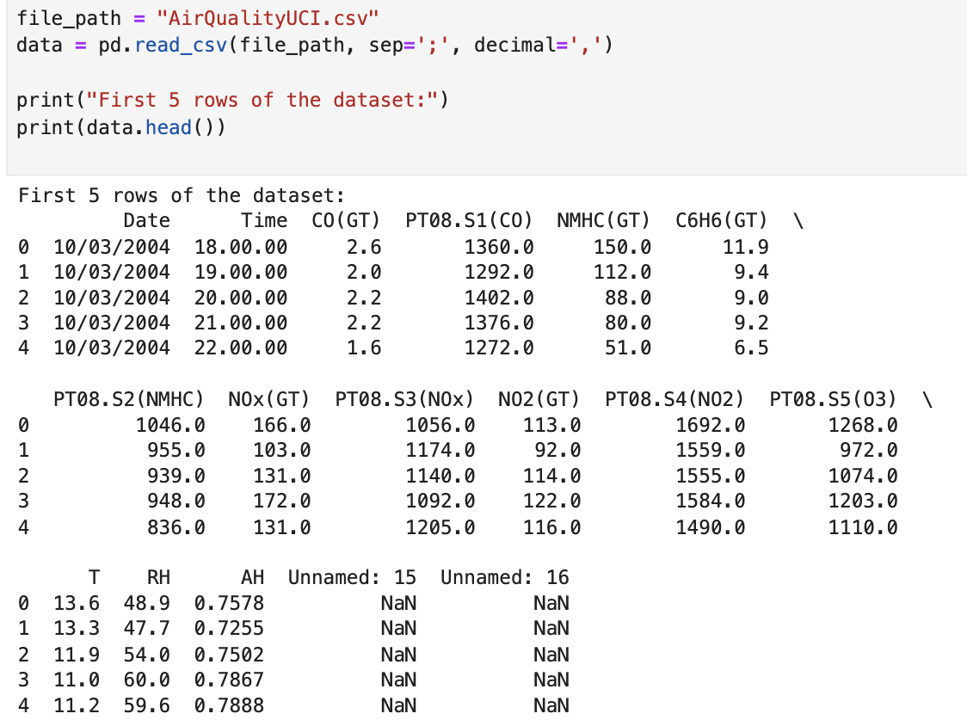
02
Dataset Overview
Dataset Source: UCI Machine Learning Repository
Dataset Name: Air Quality Dataset
Description:
Contains hourly averaged responses of an air quality chemical multi-sensor device.
Collected from an urban environment in Italy (March 2004 to February 2005).
Key Features:
Pollutants:
CO(GT): Concentration of Carbon Monoxide (mg/m³).
C6H6(GT): Benzene concentration (μg/m³).
NOx(GT), NO2(GT): Nitrogen Oxides and Dioxide concentrations (ppb).
Ozone (O3): Ambient ozone levels.
Environmental Factors:
T: Temperature (°C).
RH: Relative Humidity (%).
AH: Absolute Humidity (g/m³).
Sensor Data: Recorded sensor voltages for detecting pollutants.
Dimensions before cleaning:
Rows: 9,471
Columns: 17

Slide 5
03
Data Cleaning
Missing Value Handling:
Placeholder values (-200) replaced with NaN.
Columns with more than 50% missing values were dropped to avoid bias (e.g., NMHC(GT)).
Datetime Integration:
Combined Date and Time columns into a single Datetime column.
Converted the new Datetime column to a proper datetime format for easier analysis.
Feature Reduction:
Removed irrelevant or redundant features (e.g., Unnamed: 15, Unnamed: 16).
Outlier Treatment:
Identified and removed outliers using statistical methods.
Features were normalized to bring all variables to a comparable scale (e.g., pollutants and environmental factors).
Final Dataset Characteristics:
Initial Rows: 9,471 → Final Rows: 6,941 (after dropping rows with missing values).
Initial Columns: 15 → Final Columns: 10 (after feature reduction).

Slide 6
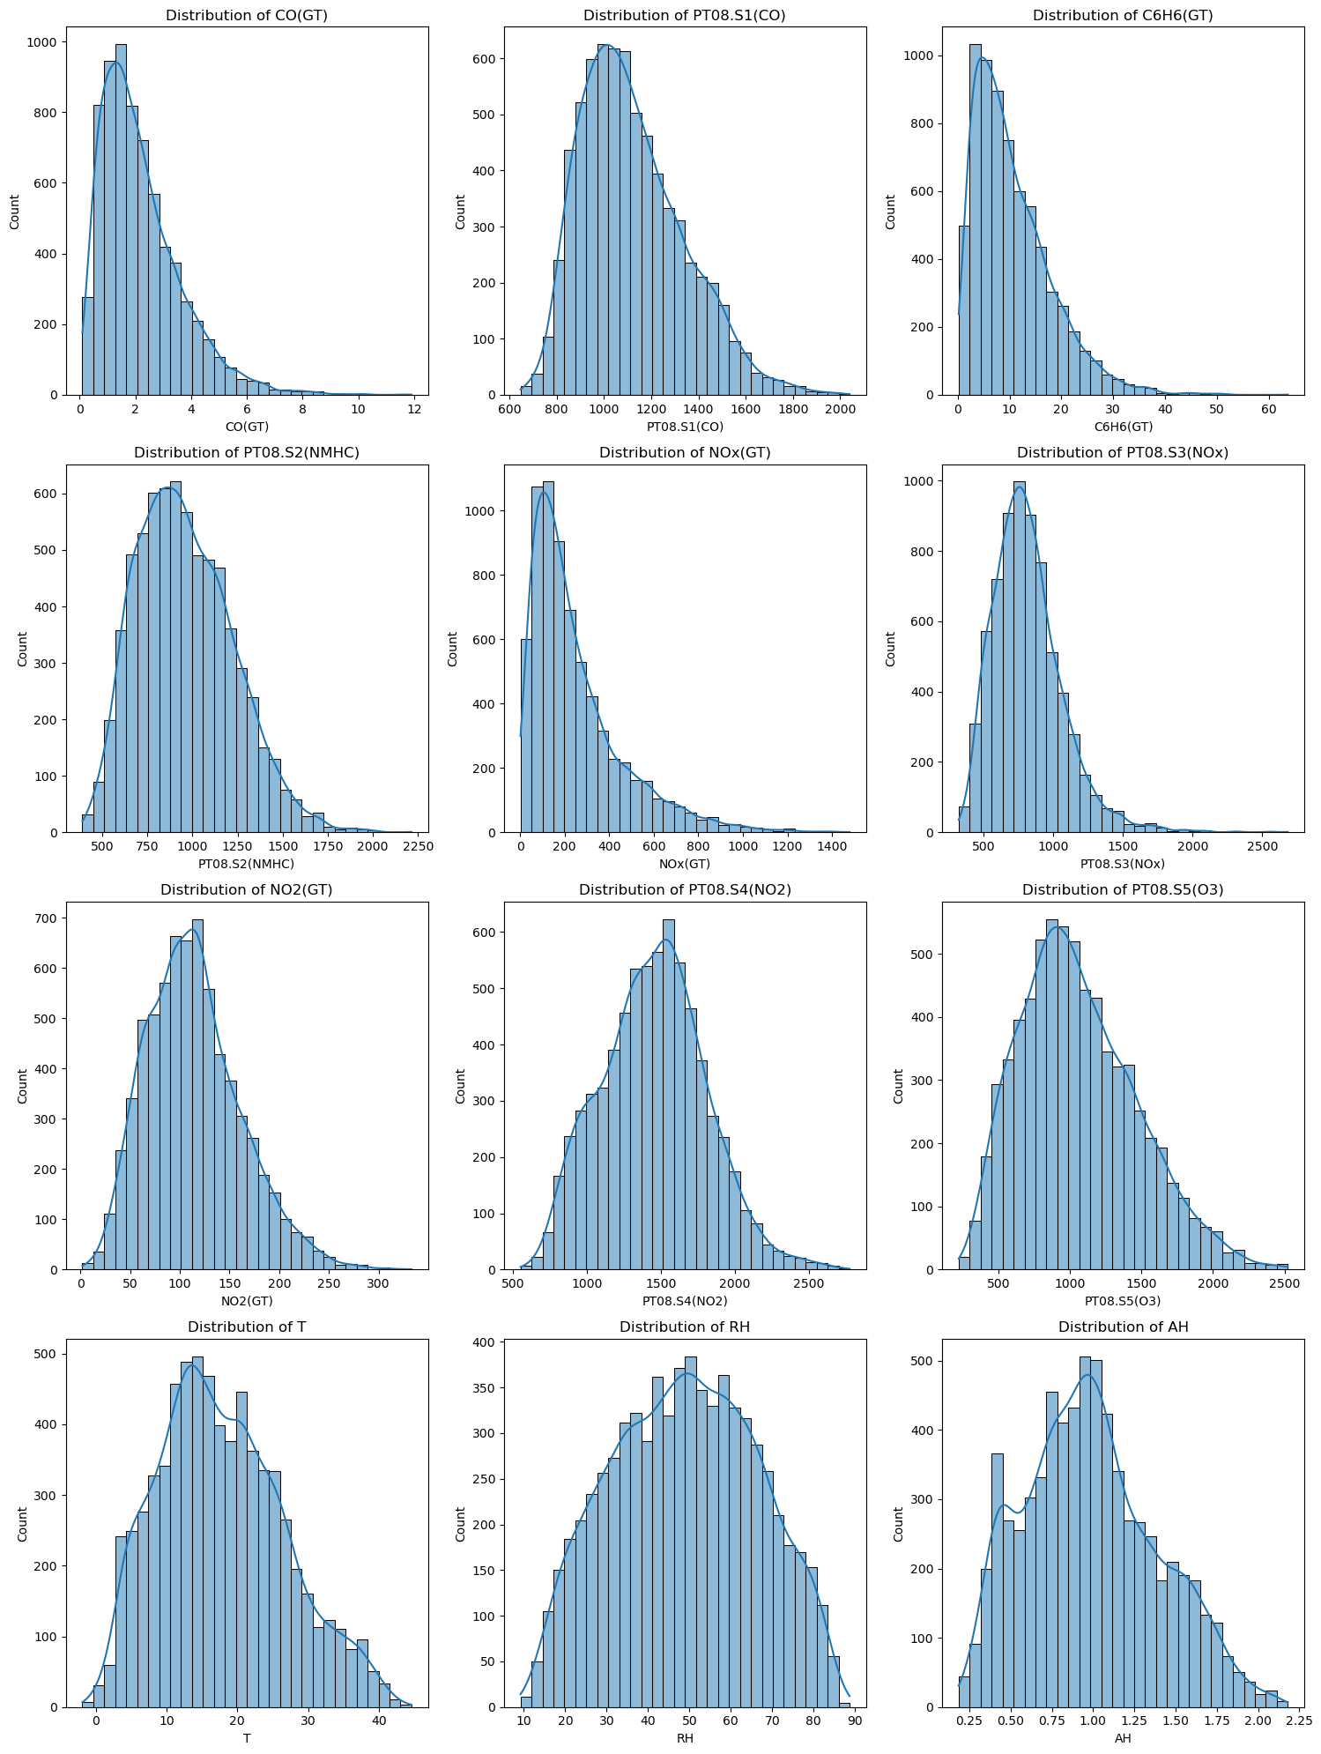
04
Exploratory Data Analysis
Pollutant Concentrations (CO(GT), C6H6(GT), NOx(GT), NO2(GT)):
Most pollutant features exhibit right-skewed distributions, with values concentrated at lower ranges.
Outliers can be observed as long tails in the distributions, indicating occasional extreme pollution events.
Sensor Readings (PT08.S1, PT08.S2, PT08.S3):
These features represent sensor responses (voltage) for specific pollutants.
Distributions are dense around central values, showing stable sensor performance in normal conditions.
Environmental Factors (T, RH, AH):
Temperature (T) has a slightly bimodal distribution, likely due to seasonal variations in the data.
Relative Humidity (RH) has a near-symmetric distribution centered around 50%, indicating average atmospheric conditions.
Absolute Humidity (AH) is slightly right-skewed, reflecting variation in atmospheric moisture levels.

Slide 7
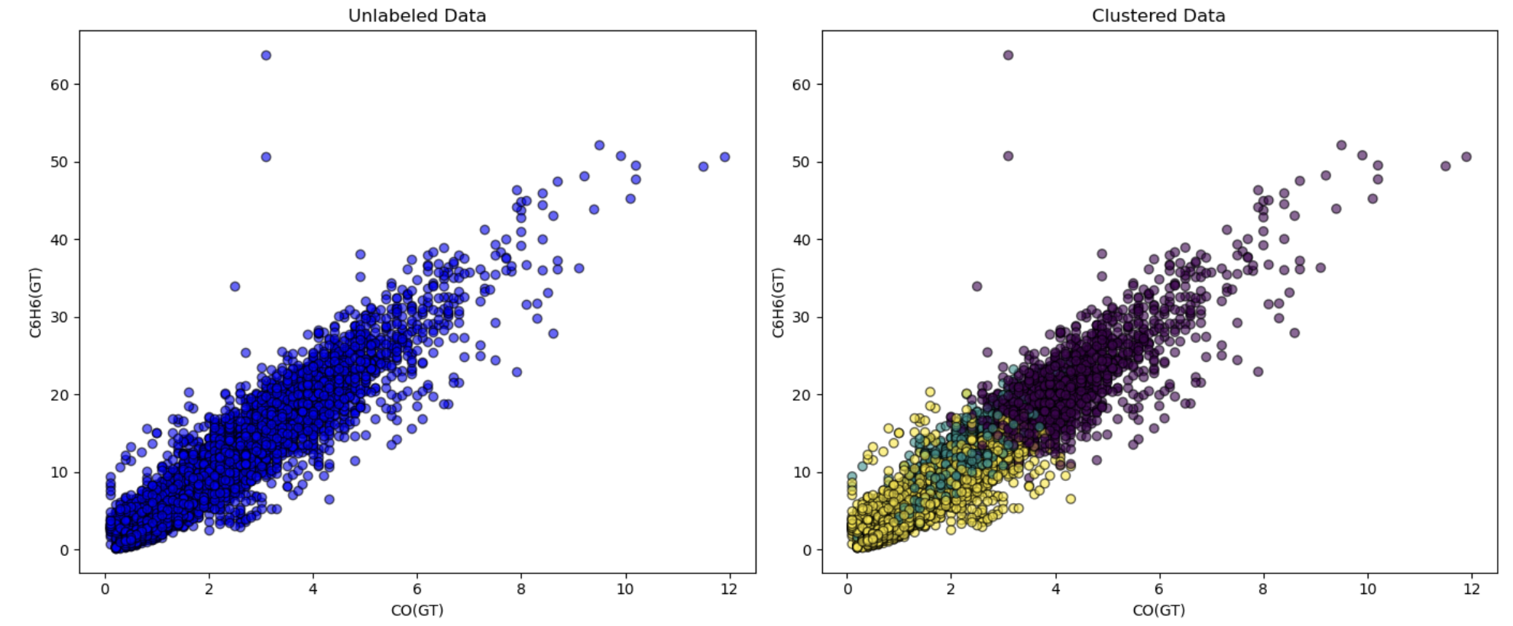
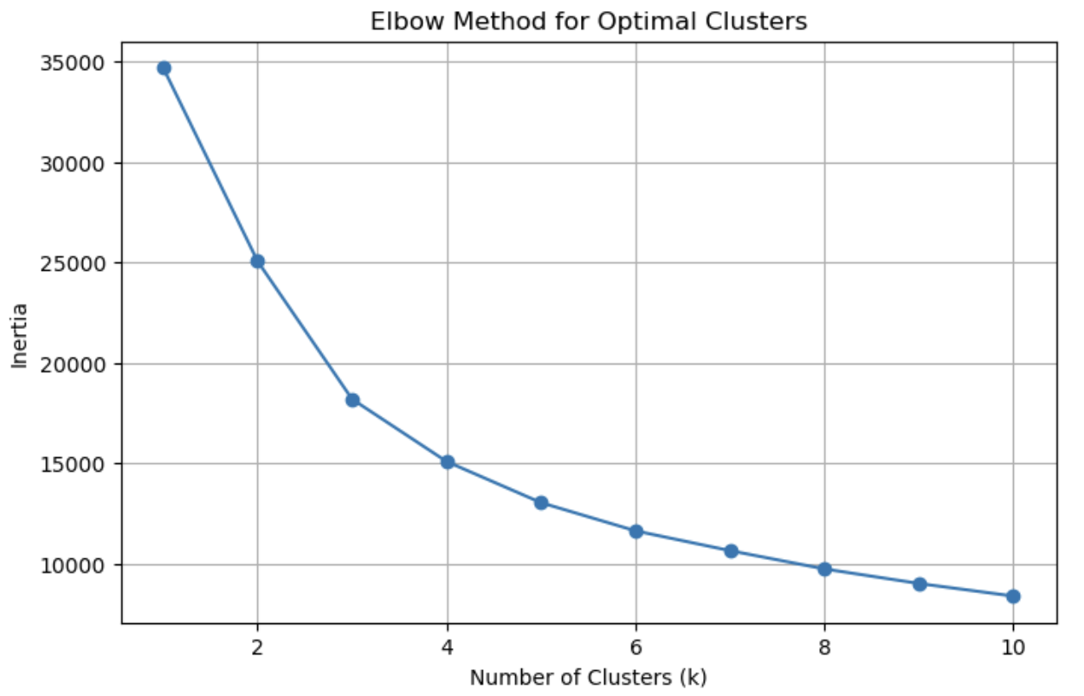
Clustering Before Dimensionality Reduction
05
Purpose: To determine the optimal number of clusters (k) for K-Means clustering.
X-Axis: Number of clusters (k).
Y-Axis: Inertia (Sum of Squared Distances within clusters).
Elbow Point: The bend in the graph (at k=3) indicates the optimal number of clusters where adding more clusters provides diminishing returns in reducing inertia.
Use k=3 clusters for the best balance between simplicity and cluster compactness.

Slide 8
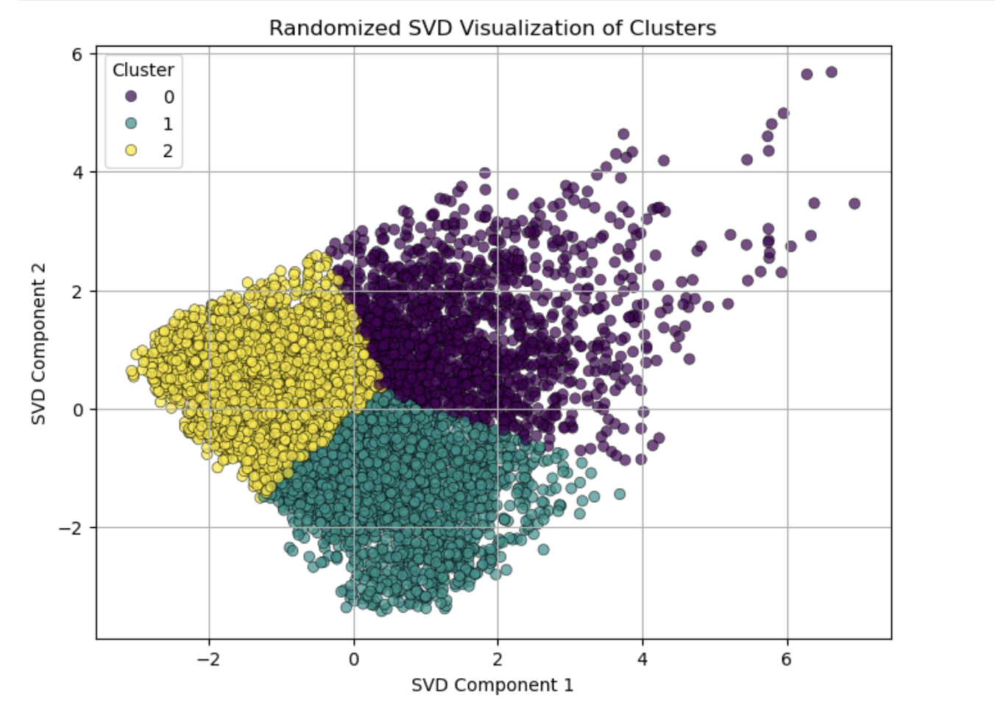
Dimensionality Reduction (Randomized SVD)
05
Reduce dimensionality to improve computational efficiency while retaining key information.
Methodology:
Applied Randomized Singular Value Decomposition (SVD).
Reduced 5 key features to 2 components for clustering and modeling.
Captured the majority of the variance in the dataset.
Observations:
Data was simplified without significant loss of information.

Slide 9
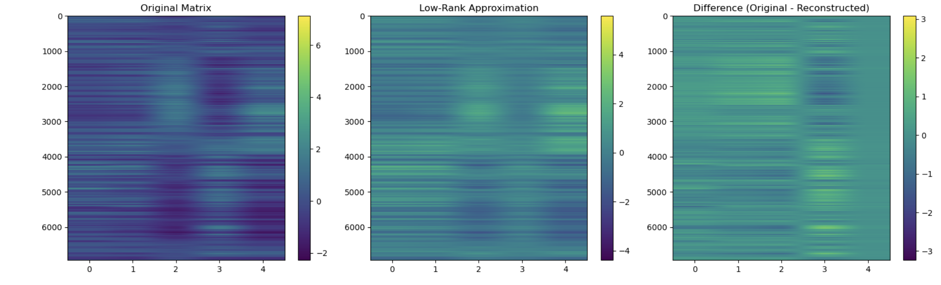
Clustering After Dimensionality Reduction
05
Re-cluster data after applying dimensionality reduction using Low Rank Approximation.
Low-rank approximation reduces the dimensionality of a dataset while retaining most of its essential information.
This is achieved by retaining only the top kkk singular values and their corresponding singular vectors using Singular Value Decomposition (SVD).

Slide 10
Predictive Modeling
06
Built linear regression model to predict pollution levels.
Before SVD: Used original features for Linear Regression.
RMSE: 0.4400, R²: 0.8975
After SVD: Used reduced components for Linear Regression.
RMSE: 0.2183, R²: 0.9747
Key Observations:
Original features gave higher accuracy but higher complexity.
Dimensionality reduction simplified modeling with minimal accuracy loss.
Model | RMSE | R²
Before SVD | 0.4400 | 0.8975
After SVD | 0.2183 | 0.9747

Slide 11
Thank You!

